Slide 1

Monitoring Factory Workers’ Daily Performance & Attrition
Muhammad Al-farisy

Slide 2


Muhammad Al-farisy
Education
Accounting – Pasundan University
Working
Data Analyst

Slide 3
Project Background

Slide 4
Project Background
The organizational structure of this factory consists of 508 permanent workers, but due to employee turnover, the number of individuals appearing in the data reaches 687 people. This indicates a change in the workforce due to layoffs, resignations, or placement of new employees.
To monitor the movement of data that is updated every day, a tool is needed to update data to users and report every day so that users can make decisions regarding the condition of the company's management employees towards the company.

Slide 5
Problem Statement

Slide 6
Problem Statement
This project aims to upgrade the process of sending data to the data warehouse and update to reporting. The main challenges include:
Build Automation ETL
Build Automated Reporting
Project Goals
Automate daily data extraction from CSV File using Airflow (Docker).
Store structured data in Postgres.
Visualization in Power BI.

Slide 7
Data Platform Understanding

Slide 8
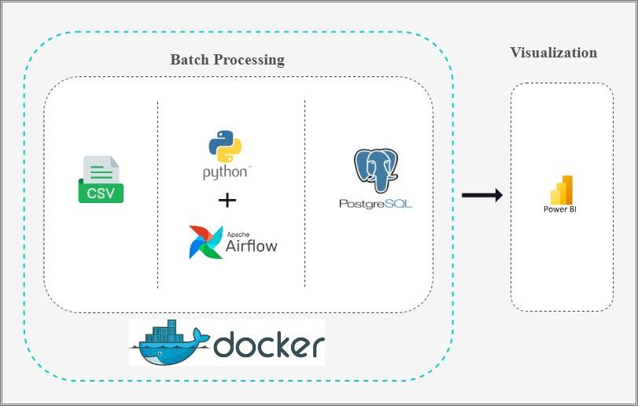

Slide 9
Data Understanding

Slide 10
Data Sources & Collection
Source: CSV (Kaggle)
Collected Data : All column.
Extraction Method: Airflow DAG (fetches data daily, saves as JSON)
Data Processing & Storage
Processing:
Cleansing “,” to “|”
Storage:
Postgres

Slide 11
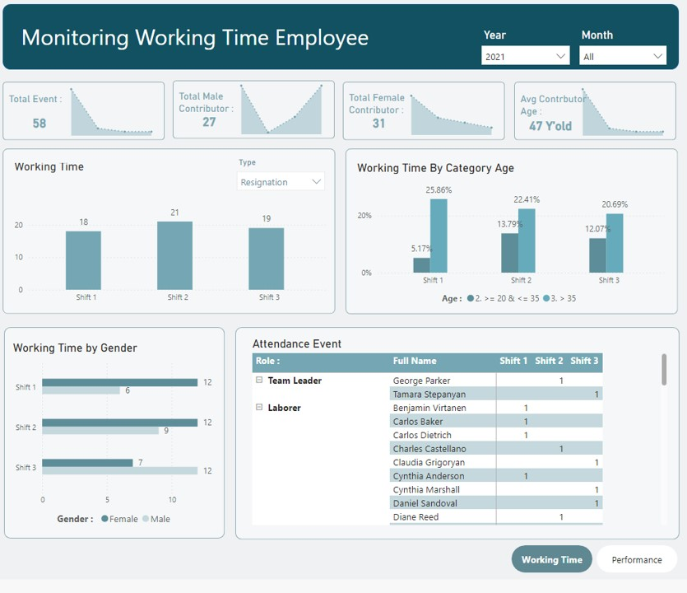
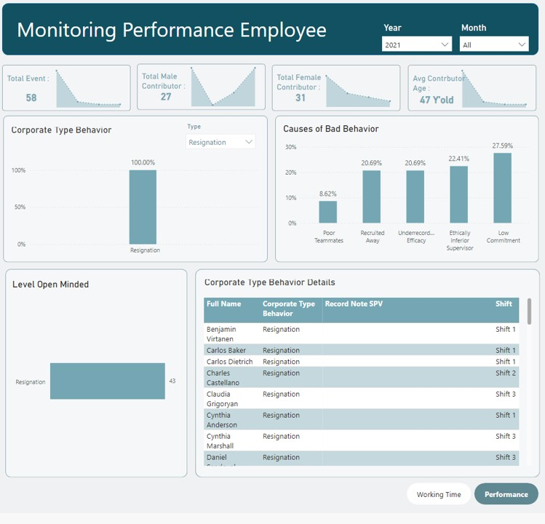
Power BI Report
Monitoring Factory Workers’ Daily Performance & Attrition

Slide 12
Conclusion & Recommendation

Slide 13
The platform is capable of processing data according to a modified schedule for use in reporting using Airflow, Postgres and Visualization.
Final conclusion: The system works well for batch analysis but can still be improved with actual processing time

Slide 14
Terima
Kasih.

